Slide 1

Final project
Hotico carla

Slide 2
What is
Pinterest is a social site where you can collect and share images of anything you find interesting. You can also visually discover new interests by browsing the collections of other Pinterest users.
Now it is mostly viewed as a search engine for users to find inspiration in different topics such as fashion, home deco, make-up, art, cars, food etc.
The web application was developed in December 2009 (11 years ago), and the first version was released in March 2010.
Although starting out as a "social network" with boards, in later years the company has put increasing emphasis in visual search and e-commerce, such as shopping catalogs.

Slide 3

Testing approach and testing tYpes
Smoke testing : with no access to the source code and the application already in production, focused on test cases that cover the most important functionalities
Negative testing : invalid inputs for login and search bar
Security testing : hidden password, account validation and using a fake email address
Exploratory testing : testing a few functionalities that the average person would use when entering the web application
Cross-browser and cross-device testing : application was tested on a laptop with Windows 10 on 3 browsers : Google Chrome, Microsoft Edge, Internet Explorer, and on a Samsung device with Android, I tested the mobile application as well as the web application on 2 browsers : Google Chrome and Internet Samsung.
End-to-end testing : from login to logout
Responsive web design test : the application should adapt to different screen sizes
API testing : Postman tool
Automated testing : Cypress framework with JavaScript
Manual test plan and execution : TestLink
Bugs and improvements

Slide 4
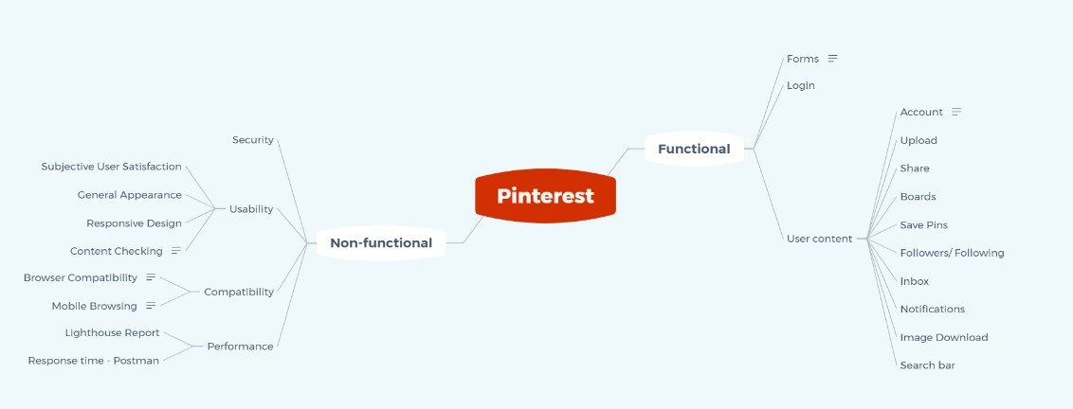
Mind map-test plan

Slide 5
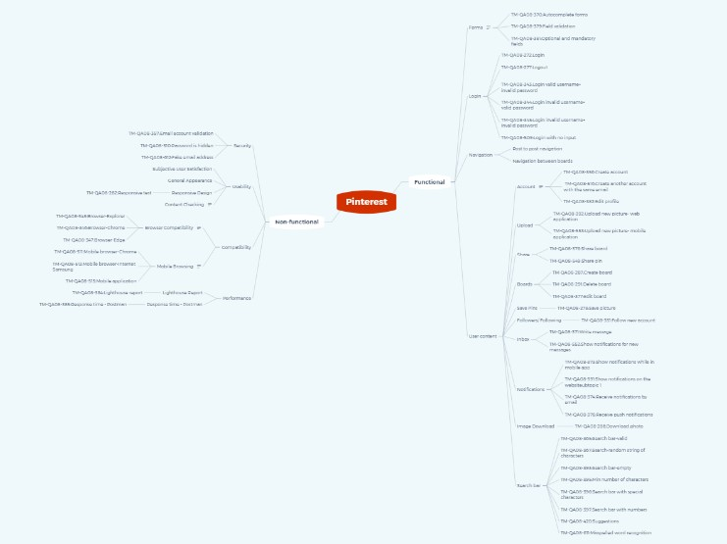
Mind map-test specification

Slide 6
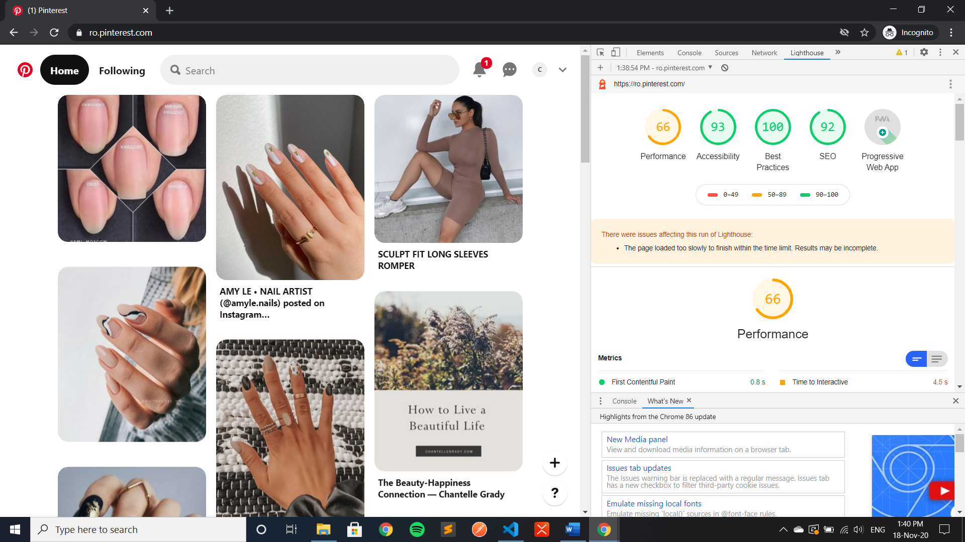
Performance-lighthouse report

Slide 7
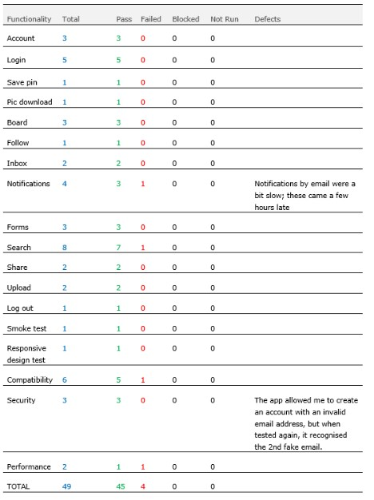
test results

Slide 8
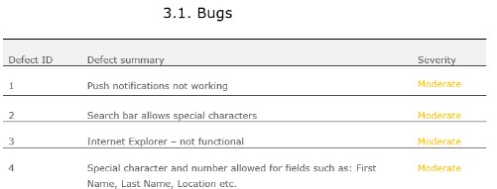

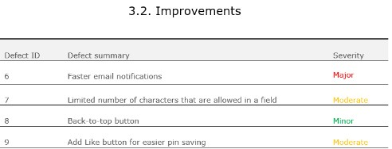
Bugs and improvements

Slide 9
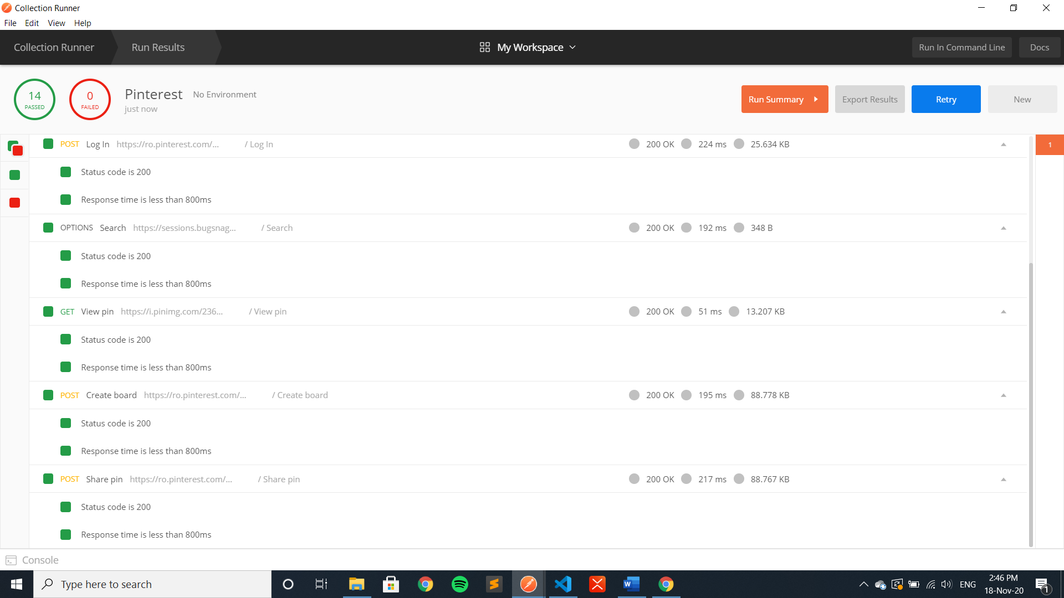
Automated tests-POSTMAN

Slide 10
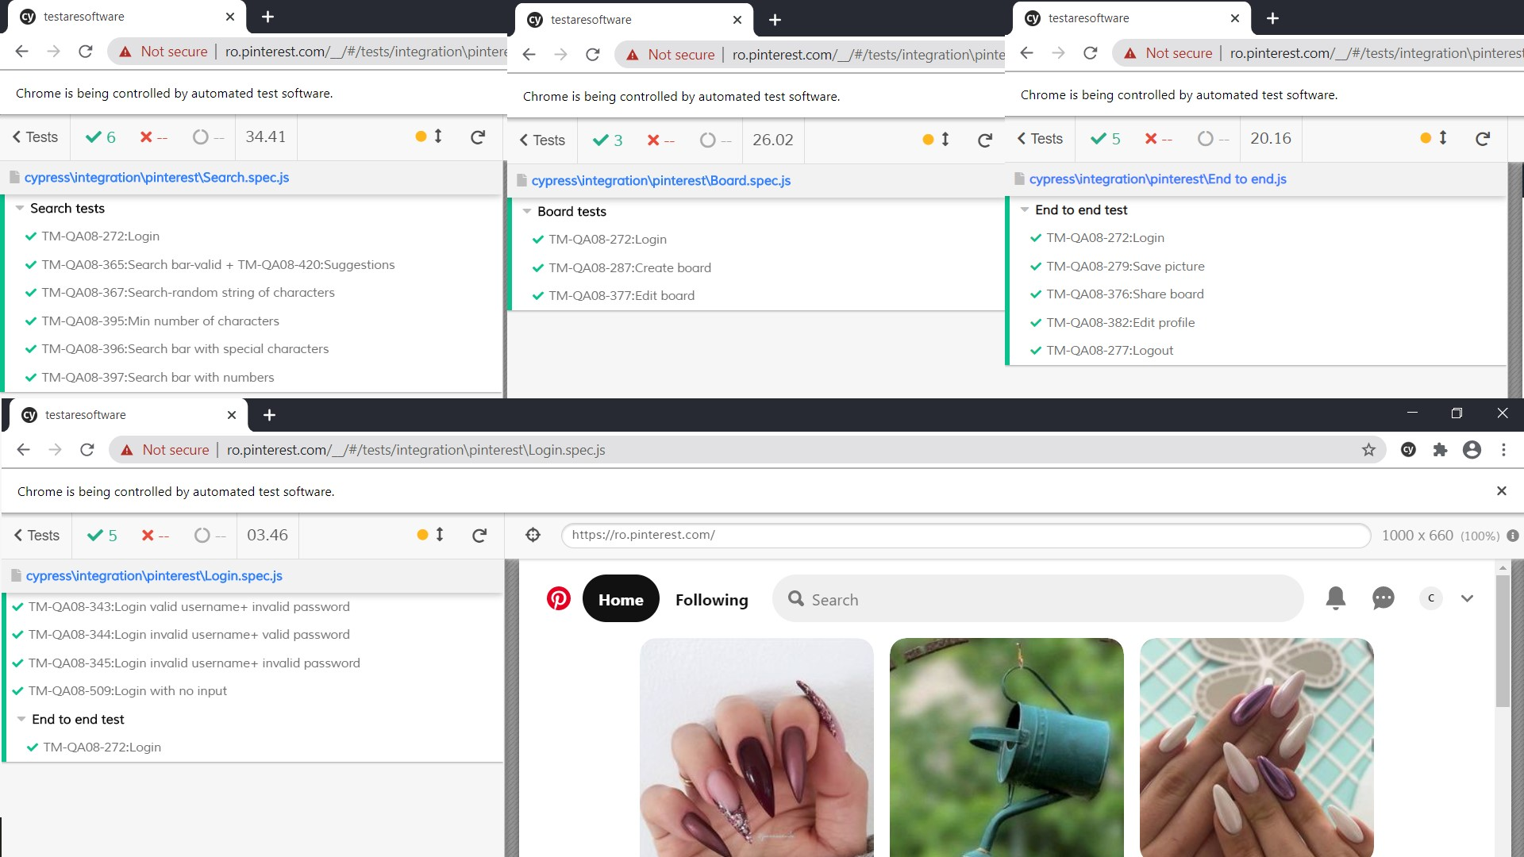
Automated tests-CYPRESS

Slide 11


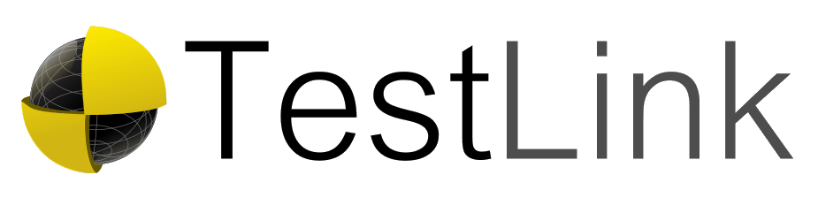



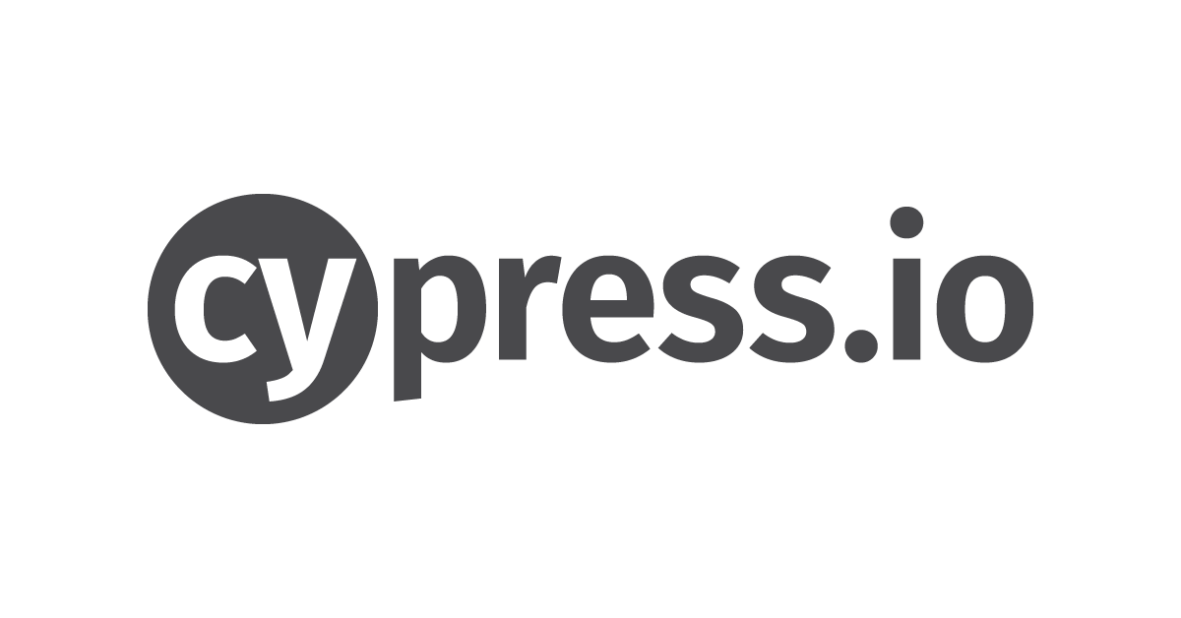

TOOLS and frameworks USED
XMind – mind maps
Microsoft Office- Word, Excel, PowerPoint
TestLink-for documenting test cases
Snip & Sketch-screenshots
Postman-automated API tests
Cypress-automated tests with JavaScript
DevTools
Visual Studio Code

Slide 12
CONCLUSIONS
Total manual test cases: 49 -45 passed(92%)
-4 failed(8%)
Functional tests: 37 (2 failed)
Non-functional: 12 (2 failed)
Total automated tests: 16(about 30%) -all passed
14 API tests focused on a few key functionalities: all passed
5 bugs were found that have to do with the notifications, validation emails, browser compatibility, text fields for forms that should not allow special characters or numbers, and special character searches.
4 improvements: late notifications, text-box limits, back-to-top button, like button for the web application
Code coverage: about 70% due to the size of the application

Slide 13
Lessons learned
The testing process was limited because of the lack of requirements and access to the source code.
Considering the size of the application and the limited time, only a few key functionalities were tested.
It is important to start with a mind map in order to make a clear plan about the tests that will be performed.
When writing test cases and bug reports, these should be clear, concise and easy to replicate.
Not all tests can be automated.
As expected, not many bugs were found, considering that the application has been in the production stage for about 10 years old, and has most likely been tested and fixed many times over the years.

Slide 14
Thank you!

